Slide 1


Sports Analytics for Team Operations Module 4
Dr. Dave Schrader
Teaching Module For Teradata University Network
Send Questions or Comments to drdaveschrader@gmail.com

Slide 2
THIS IS MODULE 4
There are two versions of the materials
You can pull the “Overview Deck” which has all the slides in one place
Or – you can access 6 modules that carve the material up
#1 – Sports is Big Business
#2 – Sports Analytics is HOT
#3 – Sports Analytics for Business Operations
#4 – Sports Analytics for Team Operations
#5 – Sports Analytics for Training, Health, and Safety
#6 – How to Get a Job in Sports Analytics

Slide 3
Team Operations Overview for 5 Sports Topic 4
Sports Analytics apply to
Later:
Rugby
Cricket
Lacrosse
Much Later – Individual Sports
Golf
Tennis
Mixed Martial Arts
Your favorite?
Baseball
Basketball
Football
Hockey
Soccer
Notes:
Module 4 – Team Operations (PowerPoint)
Provided by Dr. Dave Schrader, drdaveschrader@gmail.com
Motivation: The purpose of this module is to show students a variety of examples across 5 major sports so they understand the state of analytics use for team operations.
The educational goals for this module include:
Students should be able to define “Team Operations analytics”, which focus on player, trainer, and coach uses of analytics. With the advent of wearables and video, the sports analytics field is about to make quantum strides, so this topic is “hot”.
Students should become aware through the examples of the state of the art in each of the 5 major sports and recall at least one example for each sport.
Students should be able to go discover more team operations examples online about decision-making with data and analytics for their favorite sport (including sports not covered in this module)
Teaching NOTES on Pages of Module 4 (Page numbers refer to the master deck numbers; subtract 33 if you are looking at the subset, e.g., p. 37 in the 110 page master will be page 4 in the reduced deck. These notes are also in the Speaker Notes section on each slide.)
This is a long module. It covers just the 5 top sports in the USA, but as shown it could be much longer. Also, it only focuses on team sports, not individual sports – and their omission does not imply that these sports are not gathering and using data for analytics, too. You may not be familiar with all of these sports, so you can pick and choose from the examples that make sense to you. (I realize this is USA-centric, and will aim to make it more international as time goes by and more faculty interact with the materials and provide suggestions.) Another option, if you have the time, is to work with students to develop materials for sport not covered here, and contribute it to TUN.

Slide 4
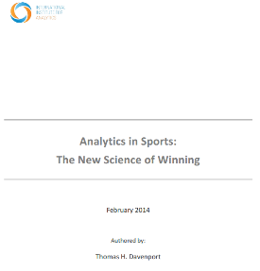

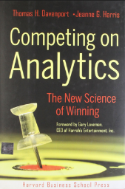
Great Source of Information
In addition to Business Operations, Team Operations are part of this must-read white paper:
Thomas Davenport, “Analytics in Sports: The New Science of Winning”, International Institute for Analytics White paper, sponsored by SAS, Feb 2014.
Source: http://www.sas.com/content/dam/SAS/en_us/doc/whitepaper2/iia-analytics-in-sports-106993.pdf
Notes:
if you are teaching all the modules then students should have read this paper already. If not, then it’s a reminder

Slide 5
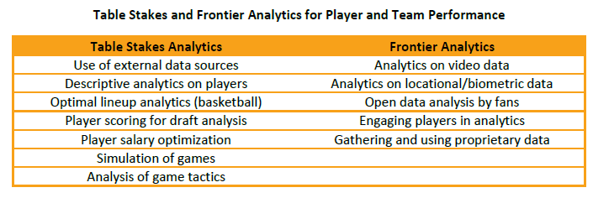
Team Operations – Analytic Areas What Do Most Teams Do? What’s Cutting Edge?
Source: Thomas Davenport, “Analytics in Sports: The New Science of Winning”, International Institute for Analytics White paper, sponsored by SAS, Feb 2014.
Source: : http://www.sas.com/content/dam/SAS/en_us/doc/whitepaper2/iia-analytics-in-sports-106993.pdf
Notes:
this is the Tom Davenport description of which analytics are in wide use (“table stakes”) vs. the ones on the cutting edge (“frontier”). Note that all sports are not at the same maturity level, so in reality what is table stakes in baseball may be frontier for hockey. (Side note – I put the salary optimization and financial analytics work in the front “Business Operations” module, reserving team operations analytics for coaches, fitness coaches, and athletes.)
This is a minor difference from how Davenport catalogues things.

Slide 6


Baseball MONEYBALL!
It all started with Bill James
Many of his first baseball writings came while he was doing night shifts as a security guard at the Stokely-Van Camp's pork and beans cannery!
Then Michael Lewis’s Moneyball book came along, describing how the Oakland A’s Billy Beane used analytics to recruit players and change play to win. Then the Movie starting Brad Pitt came out.
Most mature adopter of analytics
Society for American Baseball Research
SABR – sabermetrics, sabermetricians
See http://sabr.org/sabermetrics
Notes:
Baseball is the oldest sport to compile stats and begin the deeper use of analytics, thanks to pioneer Bill James, who built his stats database from scratch while he was working as a security guard at a pork and bean factory. You might want to have students read about Bill, and perhaps watch the Moneyball movie (or read the book), though neither delves into any data per se. But it sets the context in an entertaining way. All of this gave rise to “sabermetrics”, an entire field of baseball analytics, and students should take a look at the website.

Slide 7
Pitch f/x Database - MLB Video Cameras
Major League Baseball (MLB) creates a huge number of stats – and they are publically available
Pitch f/x:
Database of 2 million pitches,
1.15 million called pitches
Even a tool to query it : http://baseballsavant.com/pitchfx_search.php
Notes:
The good news for baseball is that there is a publically available database called Pitch f/x that you and your students can access. If your classroom is wired, then you might want to fire up the tool, take a look at the query capabilities (lots of field) and try out a query so students can see the kinds of information that is available. The example I gave was for a pitcher for the LA Dodgers but if you have a local team, you could substitute for your city/team. Note the use of visuals (from the catcher’s Point of View) to “see” all the pitches.

Slide 8
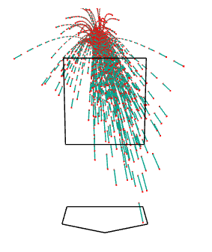
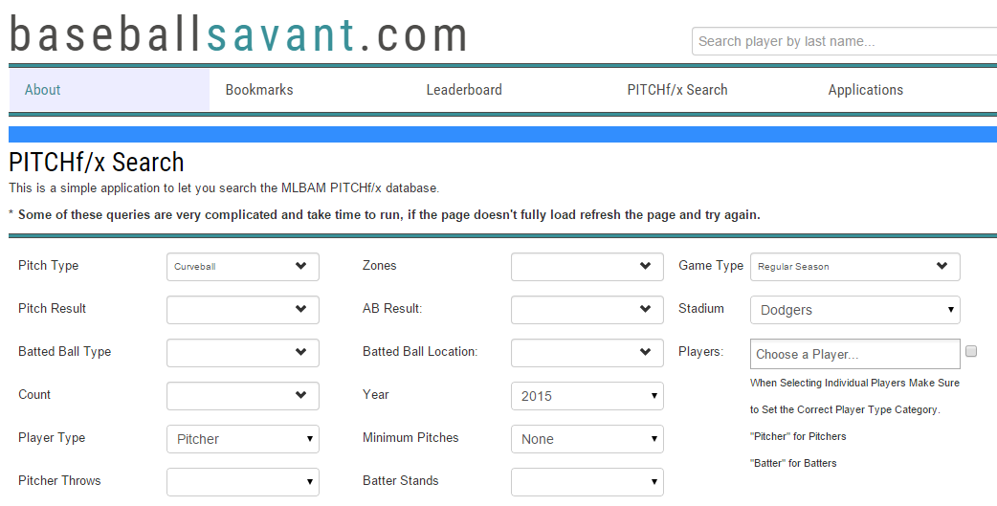
Sample Query to Pitch F/x: find curve balls thrown in Dodgers Stadium in 2015
Top Results
Mike Bolsinger threw 189 pitches
Throws curve balls 52% of the time
Visual: Catcher Point of View with strike box
Notes:
The good news for baseball is that there is a publically available database called Pitch f/x that you and your students can access. If your classroom is wired, then you might want to fire up the tool, take a look at the query capabilities (lots of field) and try out a query so students can see the kinds of information that is available. The example I gave was for a pitcher for the LA Dodgers but if you have a local team, you could substitute for your city/team. Note the use of visuals (from the catcher’s Point of View) to “see” all the pitches.

Slide 9
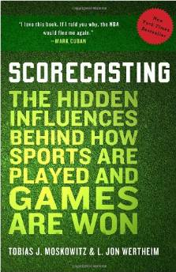
Pitch f/x Database - MLB Video Cameras
Installed in 2007 to track location of every pitch within a centimeter
Track also speed, movement, and type of pitch
Average pitch starts at 92mph, crosses plate at 85mph
Nice research for numerous sports by Tobias Moskowitz and Jon Wertheim (highly recommended)
Source: http://www.amazon.com/Scorecasting-Hidden-Influences-Behind-Sports/dp/0307591808
Notes:
if you loved the Freakonomics books, then you will enjoy this great book that contains numerous examples of more advanced analytics. This page provides more details about the cameras and the speed monitoring capabilities.

Slide 10
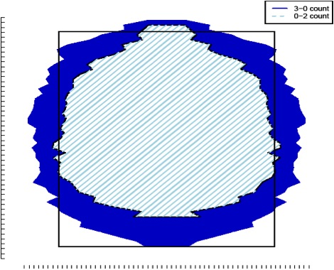
Research: Umpires and Strike Zones
Are umpires consistent?
Yes, they get it right 85.6% of the time
But situation matters
Is there a difference in calling strikes when the count is 3 balls vs. when it is 2 strikes?
Yes! Error rate of 39%
Generally err in favor of extending the game
Source: http://www.amazon.com/Scorecasting-Hidden-Influences-Behind-Sports/dp/0307591808
Notes:
this is a great example from the book (also articles online) in which they used the data to figure out umpire bias. Is the umpire influenced by crowd noise to “help” the home team? Ask the students what other factors could impact the calls. By analyzing the data, the authors found that the area of the strike box “magically” changes, depending not on the crowd but on the count. If there are 3 balls and one strike, then somehow the strike zone expands (so there is a higher probability of calling a strike instead of letting the batter walk). Conversely, if it is a 1-2 count (one ball, two strikes), then somehow the strike zone shrinks, so it is more likely that a ball is called instead of calling the batter out. In general, the bias is in favor of keeping the player at the bat. Students might want to buy and read this entertaining book, because this is just one of many, many examples.

Slide 11
Research: Can You Predict the Next Pitch?
Ray Hensberger, baseball-loving technologist in the Strategic Innovation Group at Booz Allen Hamilton, from paper presented at the MIT Sloan Sports Analytics Conference 2015
Machine learning algorithms on the 400 pitchers who threw more than 1000 pitches over 3 years
Factors: number of players on base, right-handed vs. left-handed batters, current at-bat (pitch type and zone history, ball-strike count); the game situation (inning, number of outs, and number and location of men on base); and pitcher/batter handedness
More factors: observations on pitchers that vary across ball games, such as curveball release point, fastball velocity, general pitch selection, and slider movement.
His team modeled MLB data to show with 74.5% accuracy what a pitcher is going to throw—and when.
Source: : http://www.fastcolabs.com/3033324/how-sports-data-analytics-is-upsetting-the-game-all-over-again
Notes:
we wrap up baseball with this example research paper from the MIT Sloan Sports Analytics Conference. Researchers at Booz Allen Hamilton created a machine learning model that successfully predicts the next pitch. Students can access this paper online as a homework assignment.

Slide 12
Basketball
NBA teams are rapidly increasing their analytics skills
STATS SportsVU cameras
New and innovative visuals drive competitive analytics from game film
“In the paint” and 3 point shots are higher payoff
Spacing on the court is a hot area of analysis
Long season, lots of travel are issues for the coaches and athletes
Trainers play a key role in helping with player health
Notes:
now we move to basketball, which probably is the 2nd most sophisticated (or perhaps even the most sophisticated) user of sports analytics. Baseball is slower moving and there is more of a focus on individual players, whereas basketball is fluid, requiring video analytics, and the team dynamics of 10 people moving (with variable offense and defense) makes this a very fruitful area for advanced analytics. It’s also an intense area for health and injury analytics because the season is long, the number of games is very high, and travel/fatigue/time zones are also a factor that can influence player and team performance.

Slide 13
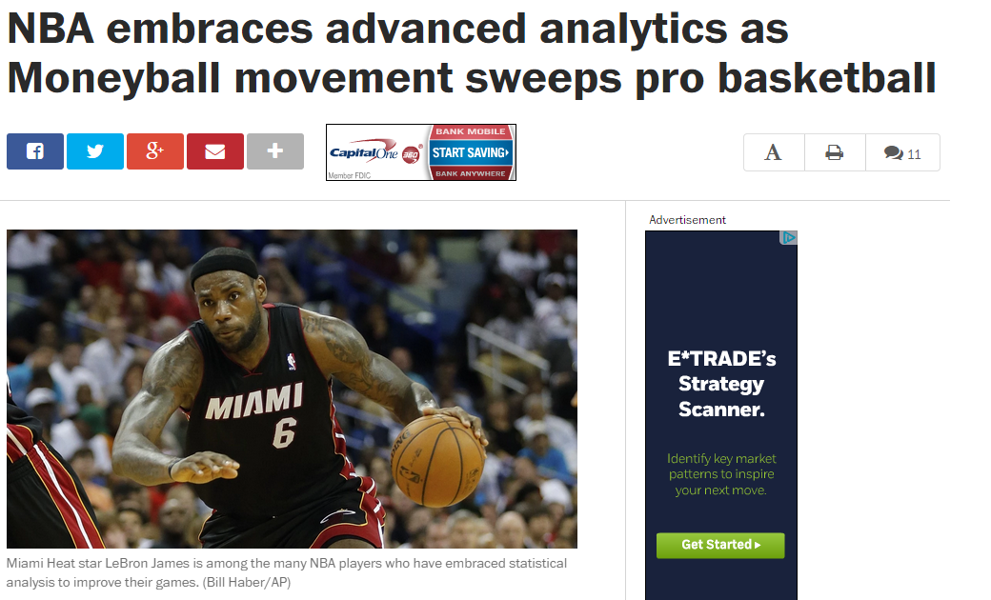
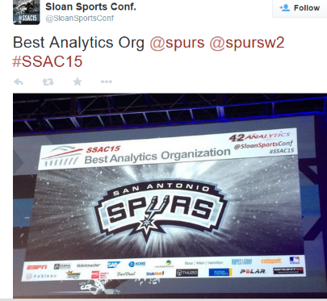
Cameras now installed in all pro arenas, STATS SportVU system captures 6 video angles for analysis
Data available to all teams – creates new core competency requirement
Source: Washington Post, Oct 23, 2013
Notes:
in 2013, the National Basketball League installed cameras in all the arenas and make the game film available to all the teams. The system is built by a company called STATS and it’s called STATS SportVu. It’s not public (like the baseball database). This trend is also happening in pro football, lagging by a year. But it’s a phenomenon that’s also happening at the college and high school level. By putting game film up on shared websites (“the cloud”), teams decrease the effort/cost of doing all this individually. There is a website called Hulu for high school game film, for example.

Slide 14
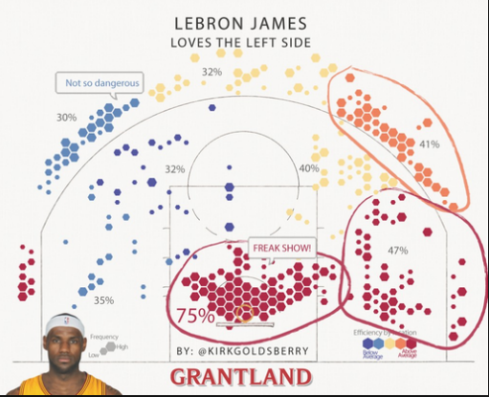
Sample Shot Visuals for An Individual
Source: Grantland, The Shape of Cavs to Come, http://grantland.com/the-triangle/lebron-james-kevin-love-kyrie-irving-cavs-offense
Notes:
See also http://grantland.com/features/how-lebron-james-transformed-game-become-highly-efficient-scoring-machine/
this visual from Grantland (a key magazine that covers basketball) shows what you can do with the information from each game. This is a shot analytic that shows, for a particular player, the spots on the court from which he shoots. You can see that LeBron James (who plays for the Cleveland Cavaliers) often shoots the ball near the basket (at the bottom of the picture). But it’s also noteworthy that he tends to like to “go left” when he dribbles down the court – which may be valuable information for a defender, especially if the percent of shots he makes on the left (41%) is higher than when he on the right (32%).

Slide 15

New Focus – Team Dynamics
Landmark Must-Read article
Kirk Goldsberry – Grantland. February 6, 2014
“Data Ball”
Project to come up with new projected scoring value metric for every move on the court
Source: http://grantland.com/features/expected-value-possession-nba-analytics/
Notes:
there is a landmark paper that students should read which takes analytics to an even higher level. Based on a research paper by Harvard, a new metric called “Expected Point Value” can be computed based on offensive player positions, their history of shot-making, the distances to the defenders, etc. While this is all calculated “after the fact”, it can be used by coaches to go back through game film and show players the likely outcome of their shooting vs. the passing the ball to a teammate. Mapping the video to dots representing players, and then annotating various actions and their expected point values is a key visual for any offensive play. The sequence concludes with an example of the last shot of a game where the player passed instead of taking a shot – which was the correct thing to do. You should definitely have students read the Grantland paper and/or the research paper online so they learn more about this kind of analytic (which will be repeated shortly when we get to hockey).

Slide 16
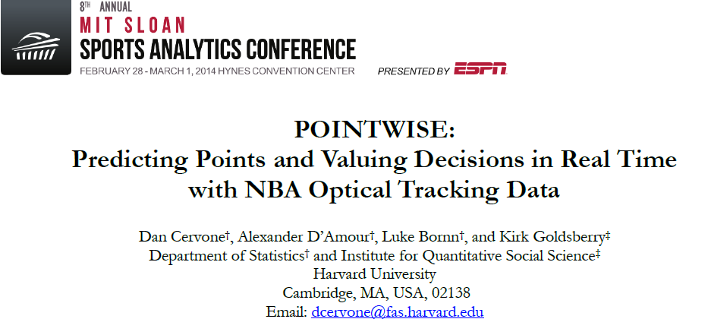
Associated Research Paper
Source: http://www.sloansportsconference.com/wp-content/uploads/2014/02/2014_SSAC_Pointwise-Predicting-Points-and-Valuing-Decisions-in-Real-Time.pdf
Notes:
there is a landmark paper that students should read which takes analytics to an even higher level. Based on a research paper by Harvard, a new metric called “Expected Point Value” can be computed based on offensive player positions, their history of shot-making, the distances to the defenders, etc. While this is all calculated “after the fact”, it can be used by coaches to go back through game film and show players the likely outcome of their shooting vs. the passing the ball to a teammate. Mapping the video to dots representing players, and then annotating various actions and their expected point values is a key visual for any offensive play. The sequence concludes with an example of the last shot of a game where the player passed instead of taking a shot – which was the correct thing to do. You should definitely have students read the Grantland paper and/or the research paper online so they learn more about this kind of analytic (which will be repeated shortly when we get to hockey).

Slide 17
New Calculation – EPV – Expected Point Value
“Competing risk model” – used computational horsepower of 500 parallel processors and two terabytes of memory to complete the analysis
The 2012-13 SportVU data set used for the paper included 800 million locations of NBA players. Keep in mind, the data was collected in only 14 NBA arenas last season — it’s collected in every arena in the 2015 season.
The database the group built for the project was 93 gigabytes.
Source: http://www.sloansportsconference.com/wp-content/uploads/2014/02/2014_SSAC_Pointwise-Predictig-Points-and-Valuing-Decisions-in-Real-Time.pdf
Notes:
there is a landmark paper that students should read which takes analytics to an even higher level. Based on a research paper by Harvard, a new metric called “Expected Point Value” can be computed based on offensive player positions, their history of shot-making, the distances to the defenders, etc. While this is all calculated “after the fact”, it can be used by coaches to go back through game film and show players the likely outcome of their shooting vs. the passing the ball to a teammate. Mapping the video to dots representing players, and then annotating various actions and their expected point values is a key visual for any offensive play. The sequence concludes with an example of the last shot of a game where the player passed instead of taking a shot – which was the correct thing to do. You should definitely have students read the Grantland paper and/or the research paper online so they learn more about this kind of analytic (which will be repeated shortly when we get to hockey).

Slide 18
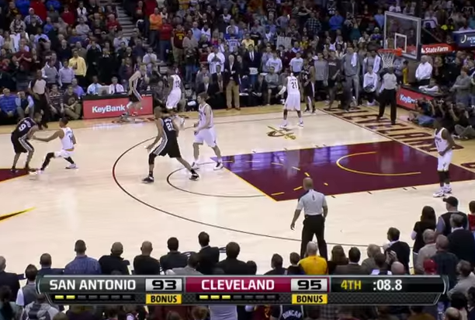
Play Analytics
8.8 seconds left, end of game
San Antonio behind by 2
Inbounding the ball
Play Video at
https://youtu.be/OVY15CHD6FQ
Under the “old way”,
Kawhi Leonard gets the credit for making the 3 pointer and winning the game.
Under the “new way”, Tony Parker gets credit for a great pass and winning the game
Source: http://grantland.com/features/expected-value-possession-nba-analytics/
Notes:
there is a landmark paper that students should read which takes analytics to an even higher level. Based on a research paper by Harvard, a new metric called “Expected Point Value” can be computed based on offensive player positions, their history of shot-making, the distances to the defenders, etc. While this is all calculated “after the fact”, it can be used by coaches to go back through game film and show players the likely outcome of their shooting vs. the passing the ball to a teammate. Mapping the video to dots representing players, and then annotating various actions and their expected point values is a key visual for any offensive play. The sequence concludes with an example of the last shot of a game where the player passed instead of taking a shot – which was the correct thing to do. You should definitely have students read the Grantland paper and/or the research paper online so they learn more about this kind of analytic (which will be repeated shortly when we get to hockey).

Slide 19
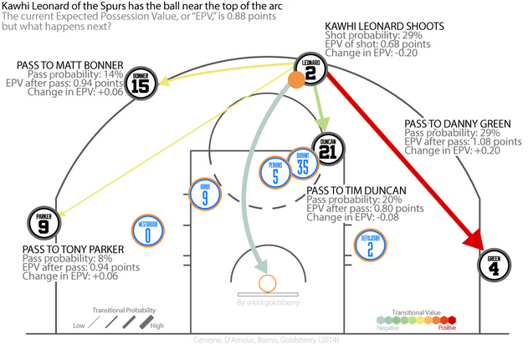
Expected Point Value
Can calculate Expected Values for passing to various teammates
EPV is the expected number of points
Updated constantly because of movement, defense
Source: http://grantland.com/features/expected-value-possession-nba-analytics/
Notes:
http://grantland.com/features/expected-value-possession-nba-analytics/
there is a landmark paper that students should read which takes analytics to an even higher level. Based on a research paper by Harvard, a new metric called “Expected Point Value” can be computed based on offensive player positions, their history of shot-making, the distances to the defenders, etc. While this is all calculated “after the fact”, it can be used by coaches to go back through game film and show players the likely outcome of their shooting vs. the passing the ball to a teammate. Mapping the video to dots representing players, and then annotating various actions and their expected point values is a key visual for any offensive play. The sequence concludes with an example of the last shot of a game where the player passed instead of taking a shot – which was the correct thing to do. You should definitely have students read the Grantland paper and/or the research paper online so they learn more about this kind of analytic (which will be repeated shortly when we get to hockey).

Slide 20
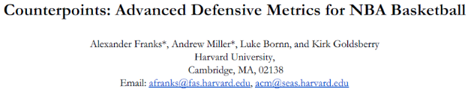
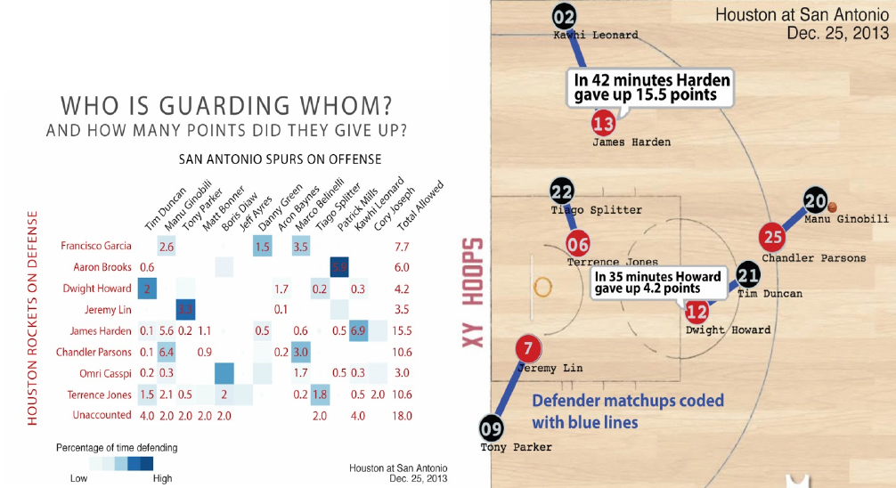
Source: http://www.sloansportsconference.com/wp-content/uploads/2015/02/SSAC15-RP-Finalist-Counterpoints2.pdf
Notes:
shows an example of competitive analytics for basketball. Who guards who, and how effectively, is something that coaches and players need to know. Like the previous example, there is an associated research paper for students who might want to study this at a deeper level.

Slide 21
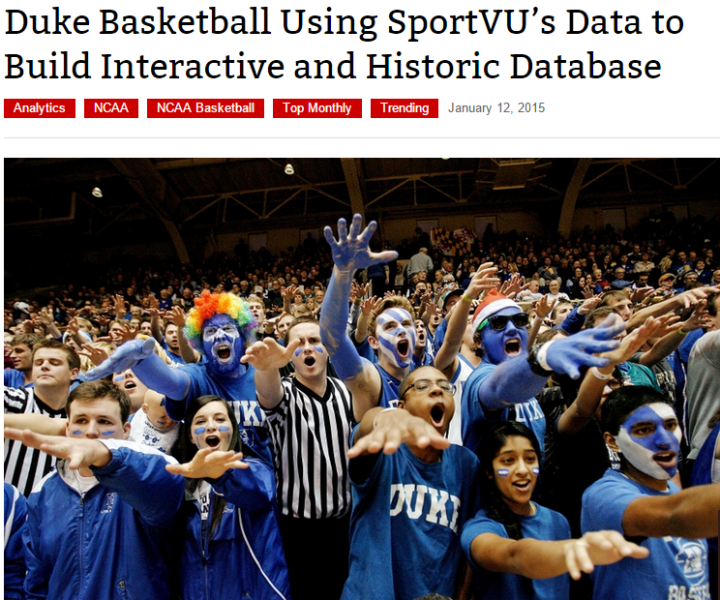
Analytics Now Moving Down to the College Level
Source: http://www.sporttechie.com/2015/01/12/duke-basketball-using-sportvu-data-to-build-interactive-and-historic-database
Notes:
Duke is a powerhouse college basketball team. As you might expect, anything that the pros are doing will eventually move down to the college (and ultimately, high school) level. In this case (which I heard about at the MIT SSAC 2015 event), the Duke Basketball team bought and installed SportVu for their arena and is now analyzing the data. What’s very interesting is that they have made doing the analytics a university-wide activity, engaging business school students as well as computer science students to help with the analytics. They even engage their fans by providing data to them, too! Students might want to take a look at the cited Duke online information as a homework assignment.

Slide 22

Duke Basketball Ryan Craig – leads Duke University Digital Media (web, social media)
Goal: “Engage the entire university” – students, faculty, even fans
Digitized 109 years of Duke basketball info, create a Duke Stats database, make available to fans, built up #dukebb and the GoDuke.com website
“By Duke, For Duke” was the tagline for this project
Cross-department help in analyzing data to help their teams from the Duke Fuqua Business school faculty and students, from the CS department, and from the Co-Innovation Lab
V1 project – put up stats and some simple comparisons of current Duke players to their stars of the past.
Next step: encouraging fans to calculate shot locations for players or opponents, and do hackathons with lots of visualizations to get new insights from Duke fans and students that may be valuable for their coaches and players
Go beyond basketball to all 22 Duke sports
Source: Notes from the MIT SSAC Panel - http://www.sloansportsconference.com/?p=15876
Notes:
Notes on the panel I took. This is a great idea that might drive your business school’s collaboration with your sports teams. Good discussion topic for the class – what could you do to help?

Slide 23
Football
Is in #3 position on the use of advanced analytics by pro leagues
Driven by
More stats – for fans, experts on TV/radio
Team operations – competitive edge
Player safety
Big issue – there are far fewer games to analyze, so far less data
Player safety is a huge concern, especially as players get bigger and concussions or injuries create headlines
Notes:
The next sport is football, which I would put in the #3 position in terms of maturity (maybe tied with, or even behind soccer in Europe). There are some important differences to the other sports. The number of players (11 on 11) is higher than basketball (5 on 5), and there are far, far fewer games than teams in the MLB or NBA play. Also the play is more “violent” so there are many more opportunities for injuries and concussions, a hot topic of discussion and headlines. So the league is using analytics to make improvements in player safety. The rate of adoption varies across the different teams (you can go back to the ESPN article rating proficiency as a reference point).

Slide 24
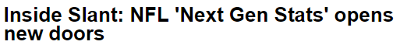
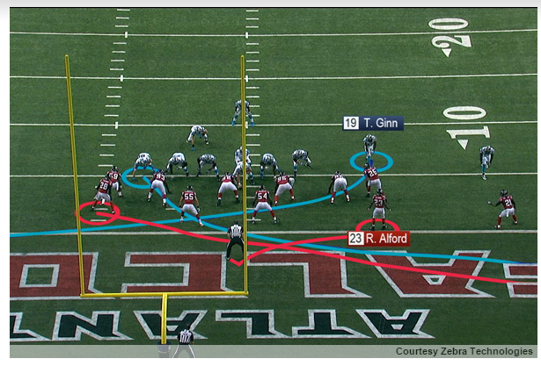
Fans – What’s Coming
Q4 at Lambeau Field: Jordy Nelson sprinted from the Green Bay Packers' 40-yard line to the Atlanta Falcons' 37, cut toward the middle of the field on a post route, caught Aaron Rodgers' pass at the 12 and turned upfield again for a 60-yard touchdown. In almost real time, ESPN's production truck had received multiple data points about the play, from Nelson's speed (in miles per hour), to the precise yardage he ran, to the distance between him and the defenders who were trying to cover him.
Source:http://espn.go.com/blog/nflnation/post/_/id/153569/inside-slant-nfl-next-gen-stats-opens-new-doors
Notes:
See also http://espn.go.com/blog/nflnation/post/_/id/162624/inside-slant-endless-possibilities-for-nfls-next-gen-stats (more recent article)
ESPN televises many of the pro games, and they are interested in analytics for fan engagement reasons. They are developing “Next Gen Stats” as illustrated that will show, during instant replay, not just the routes that players ran, but also new information like how fast they were running, what the distances and closing speeds of defenders are, etc.

Slide 25
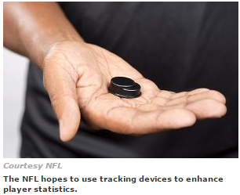
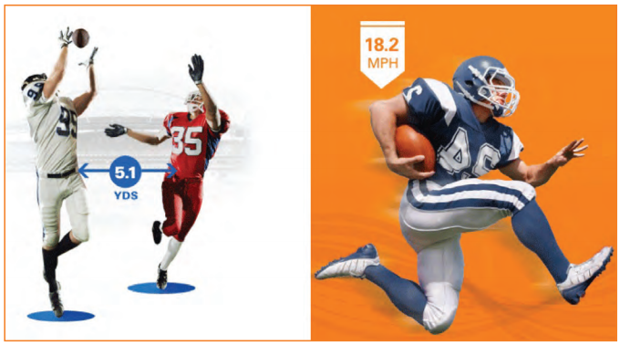
NFL Football – What’s Happening
Zebra tracking devices under the shoulder pads
Signals monitored during games in real-times
Converted into new “stats” for annotating replays
Source: www.zebra.com, and https://www.zebra.com/us/en/nfl.html
Notes:
they are able to do this because of a tech company called Zebra. They originated the idea of putting RFID tags on merchandise and tracking it through the supply chain. They have formed a new business unit which works with NFL teams to put RFID tags under the shoulder pads, and with the use of sensors at multiple points in the stadiums, can gather player movement and speed information in real-time, for use with instant replay. The trials of this in 2014 with a handful of teams were successful so there will be a full rollout in fall 2015. Students might want to read the associated articles.

Slide 26
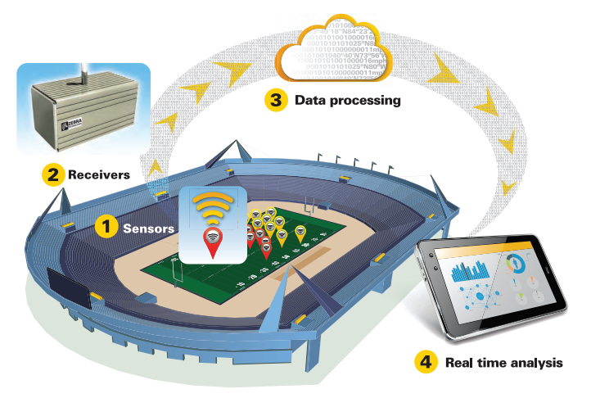
NFL Football Zebra: Data Capture -> Insights -> Analysis -> Action
Source: https://www.zebra.com/us/en/nfl.html
Notes:
http:they are able to do this because of a tech company called Zebra. They originated the idea of putting RFID tags on merchandise and tracking it through the supply chain. They have formed a new business unit which works with NFL teams to put RFID tags under the shoulder pads, and with the use of sensors at multiple points in the stadiums, can gather player movement and speed information in real-time, for use with instant replay. The trials of this in 2014 with a handful of teams were successful so there will be a full rollout in fall 2015. Students might want to read the associated articles.
//www.fastcolabs.com/3033808/the-nfl-announces-its-tracking-rfid-chips-on-every-player-for-2014

Slide 27
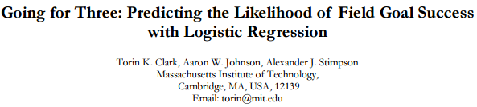
MIT Research Paper, from Sloan Sports Analytics Conference, 2013
See also the 25 minute video on YouTube at : https://www.youtube.com/watch?v=scEhJdBytu8
Source: ://www.sloansportsconference.com/wpcontent/uploads/2013/Going%20for%20Three%20Predicting%20the%20Likelihood%20of%20Field%20Goal%20Success%20with%20Logistic%20Regression.pdf
Notes:
Going for 3 – a field goal in football can be kicked by the offensive team at any point and will count as 3 points
This example shows how an analytic model was built to determine which of many factors determine the success of field goal kicking.
Paper: http://www.sloansportsconference.com/wp-content/uploads/2013/Going%20for%20Three%20Predicting%20the%20Likelihood%20of%20Field%20Goal%20Success%20with%20Logistic%20Regression.pdf
Video http://www.sloansportsconference.com/?p=10200

Slide 28
Going for 3 Points – Which Factors Matter? Binomial Logistic Regression Model for All FGs in 2000-2011 Seasons
Environmental Factors
distance,
cold temperature (<50),
field surface (artificial)
altitude (>4000ft)
precipitation,
wind (>10mph)
humidity (>60%)
Psychological Factors
regular vs. postseason,
situational pressure,
home/away,
whether kicker was iced
YES!
NOPE!
YES!
NOPE!
YES!
NOPE!
YES!
NOPE!
YES!
11,896 attempts,
3410 games, 51 stadiums
YES!
NOPE!
Source: ://www.sloansportsconference.com/wpcontent/uploads/2013/Going%20for%20Three%20Predicting%20the%20Likelihood%20of%20Field%20Goal%20Success%20with%20Logistic%20Regression.pdf
Notes:
Here’s a list of many of the factors. Distance from the field goal, obvious, but do environmental factors like temperature, and weather like rain or snow matter? How about whether they are playing on grass or artificial turf? At an elevation like “Mile High” Denver vs. Miami? And does wind matter? And what about the psychological factors – like whether it is a regular game or a playoff game? Does home vs. away field matter? Crowd noise? Does “icing the kicker” (taking a timeout to cause the field goal kicker to have to “think about” the kick) matter? This is an animated slide – you can have some fun asking the students to guess which factors predict field goal success, then show them the (hopefully surprising) result of the model. On the last page, it shows in a very practical way that the decision a coach makes depends on the stadium – some are notoriously hard or easy with regard to field goals.

Slide 29
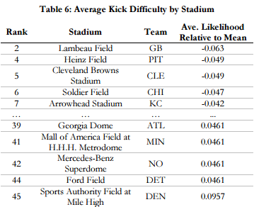
Going for 3 – Does the Stadium Matter?
Top 5 Most Difficult
(Outdoors, Cold!)
Top 5 Easiest
(Indoors, Altitude)
Source: ://www.sloansportsconference.com/wpcontent/uploads/2013/Going%20for%20Three%20Predicting%20the%20Likelihood%20of%20Field%20Goal%20Success%20with%20Logistic%20Regression.pdf
Notes:
Paper: http://www.sloansportsconference.com/wp-content/uploads/2013/Going%20for%20Three%20Predicting%20the%20Likelihood%20of%20Field%20Goal%20Success%20with%20Logistic%20Regression.pdf
Video http://www.sloansportsconference.com/?p=10200
This page shows in a very practical way that the decision a coach makes depends on the stadium – some are notoriously hard or easy with regard to field goals.

Slide 30
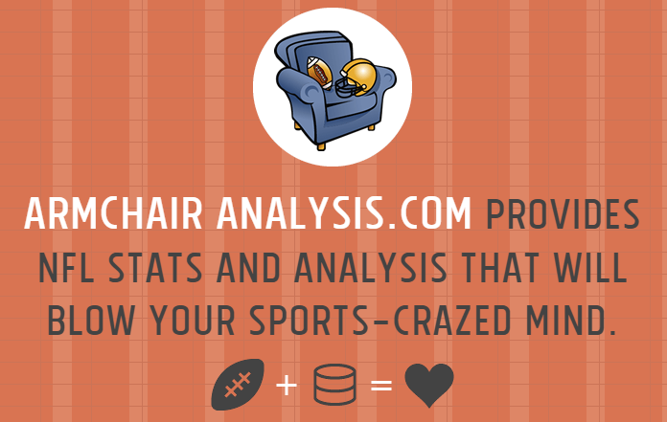
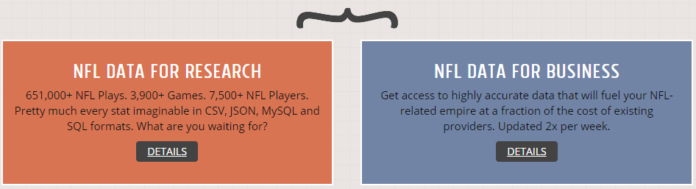
Football – Pro Data for Fans
Modestly-priced data for sale, including up-to-date subscription option for current data
Many fantasy football fans use this!
Source: www.armchairanalysis.com
Notes:
like Baseball and Basketball, there are some databases that have been built up. This one is publically available and comes in two variations – a historical database for onetime fee, or a more up-to-date subscription fee-based database often used by Fantasy Football league players.

Slide 31
Hockey
Hockey (NHL) lags way behind the other leading pro sports leagues in adoption of sports analytics
However, they are starting to catch up
Leader: Toronto Maple Leafs
Notes:
Hockey lags behind the other sports but is starting to catch up. (One of the colorful characters who coaches the Calgary Flames who is still not yet a believer is in an MIT video recommended on the Future of the Game in the last section). Toronto is hopping on the bandwagon, possibly because their team needs help!

Slide 32


Research – Hockey Analytics
Stephen Pettigrew, Research Paper at MIT SSAC15
Grad student at Harvard, created rinkstats.com (amazing!)
Source: http://www.sloansportsconference.com/wp-content/uploads/2015/02/SSAC15-RP-Finalist-Assessing-the-offensive-productivity-of-NHL-players2.pdf
Notes:
at the MIT SSAC 15 event, a person I met is a graduate student in government (using data to make election forecasts) but on the side he built a hockey database which is available. He presented a great paper that showed that on traditional metrics for recruiting, 2 players look almost the same. But then he applied Expected Value analysis, somewhat like the Basketball example, to calculate the value-add of a particular player being in the game (and contributing to the overall team, not just scoring himself), weighted by how important each goal was (e.g., contributing when the score is tied counts for more than when the game is a blowout). When he re-applies the new metrics to 2 possible recruits, there is a sizeable difference in their potential impact.

Slide 33
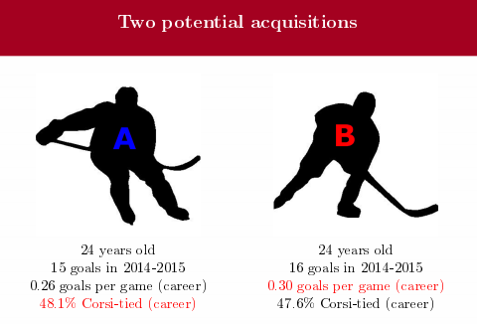
Hockey Recruiting
Which Player Should We
Draft?
http://www.matchsticksandgasoline.com/2011/7/29/2290643/understanding-advanced-stats-part-one-corsi-fenwick
Source: http://www.sloansportsconference.com/wp-content/uploads/2015/02/SSAC15-RP-Finalist-Assessing-the-offensive-productivity-of-NHL-players2.pdf
Notes:
Side note: At its most basic level, Corsi is the plus/minus amount of shots directed at a net while at even strength-blocked shots, shots high and wide, shots that hit, shots that get tipped, etc. A player who has a positive Corsi has more shots directed towards the opponents net while he is on the ice at even strength then shots directed towards his own net under the same criteria. All 10 players on the ice are used when calculating this metric.

Slide 34
Analytic for “Added Goal Value” (AGV)
How much above the “average player” does any particular player contribute in terms of offense?
Incorporates the context of WHEN the goal is scored
Also incorporates factors like power-plays
Can also calculate in-game win probabilities at any point in time
Source: http://www.sloansportsconference.com/wp-content/uploads/2015/02/SSAC15-RP-Finalist-Assessing-the-offensive-productivity-of-NHL-players2.pdf
Notes:
Pettigrew at the MIT SSAC 15 event,
a person I met is a graduate student in government (using data to make election forecasts) but on the side he built a hockey database which is available. He presented a great paper that showed that on traditional metrics for recruiting, 2 players look almost the same. But then he applied Expected Value analysis, somewhat like the Basketball example, to calculate the value-add of a particular player being in the game (and contributing to the overall team, not just scoring himself), weighted by how important each goal was (e.g., contributing when the score is tied counts for more than when the game is a blowout). When he re-applies the new metrics to 2 possible recruits, there is a sizeable difference in their potential impact.
paper, MIT SSAC 15

Slide 35
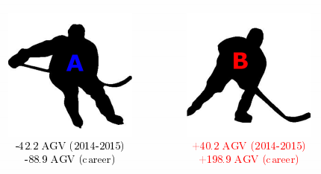
Added Goal Value – New Factors
Source: http://www.sloansportsconference.com/wp-content/uploads/2015/02/SSAC15-RP-Finalist-Assessing-the-offensive-productivity-of-NHL-players2.pdf
Notes:
Pettigrew Paper SSAC15

Slide 36
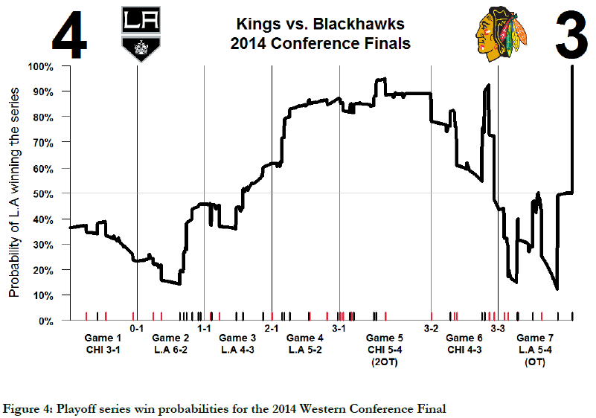
Better Visual: In-Game Win Probabilities See app at winprobs.rinkstats.com
Source: Try app at winprobs.rinkstats.com
Notes:
Pettigrew – this is a new graphic that this Harvard student created to dynamically calculate the probability of winning a game, as each score occurs. Yet another way to visualize data.
IT SSAC15

Slide 37
Soccer
Europe is ahead of the United States
MIT Panelist = Head of Analytics from FC Bayern Munich
English Premier League (EPL)
Notes:
we finish by taking a look at the state of Soccer. The Europeans are ahead of the USA in terms of establishing analytics teams, as evidenced by the comments by the head of analytics for FC Bayern Munich.

Slide 38

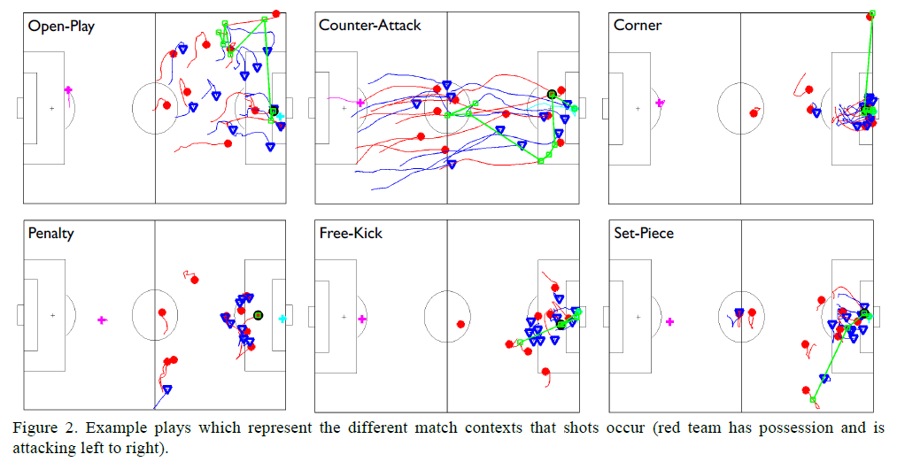
Visualizing Soccer Plays Disney Research
Source: http://www.sloansportsconference.com/wp-content/uploads/2015/02/SSAC15-RP-Finalist-Quality-vs-Quantity.pdf
See also http://www.sloansportsconference.com/wp-content/uploads/2014/02/2014_SSAC_Win-at-Home-Draw-Away.pdf
Notes:
shows the results from a Disney Research paper at the MIT forum. Note that these visuals on different play types are quite similar to what could be done for football or basketball. You can assign the paper (available online) as a reading assignment if you want

Slide 39

West Ham United FC
General Manager Allardyce’s teams have generally not been the beneficiary of limitless resources from billionaire owners. Therefore he has had to succeed by smart decisions instead of deep pockets.
Allardyce recognizes the value in data and the application of analytics, and works with his support staff and team of analysts as well as specialist analytics partners who can utilize statistical analysis software.
His teams have also been early adopters of new technology, including CRM, GPS devices, video, and sleep monitoring.
Source: Thomas Davenport, “Analytics in Sports: The New Science of Winning”, International Institute for Analytics White paper, sponsored by SAS, Feb 2014.
Source: http://www.sas.com/content/dam/SAS/en_us/doc/whitepaper2/iia-analytics-in-sports-106993.pdf
Notes:
information is from the Tom Davenport, describing Westham FC in the UK. The description provides a good summary for all the sports on the potential of analytics. This story also points out that sometimes it is the smaller teams who don’t have the budgets of the big teams who can get a competitive edge by investing in analytics (much like the Oakland A’s in the Moneyball story).

Slide 40
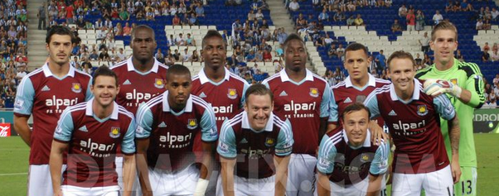
West Ham United FC
At West Ham, General Manager Allardyce and his staff are deploying data and analytics in several different areas:
1. Support for individual game strategy: competitive intelligence and tactical options
2. Insights on player performance to provide specific conditioning and strengthening
3. Modelling patterns of injuries with the ultimate goal of prediction and prevention
4. Sharing of performance analysis with players to reinforce messages and empower them to take ownership of their performance improvement.
Source: Thomas Davenport, “Analytics in Sports: The New Science of Winning”, International Institute for Analytics White paper, sponsored by SAS, Feb 2014.
Source: http://www.sas.com/content/dam/SAS/en_us/doc/whitepaper2/iia-analytics-in-sports-106993.pdf
Notes:
information is from the Tom Davenport, describing Westham FC in the UK. The description provides a good summary for all the sports on the potential of analytics. This story also points out that sometimes it is the smaller teams who don’t have the budgets of the big teams who can get a competitive edge by investing in analytics (much like the Oakland A’s in the Moneyball story).

Slide 41

FC Bayern Munich – Michael Niemeyer (Notes from MIT SSAC15 Panel, Feb 2015)
Focuses on using sensors, video and data to provide a competitive edge. A big goal is integrating the data so medical, salary, match and player data is not in silos. “We spend a lot of time on small details”.
Can’t use TV video because we need a panoramic view.
“We have 8 people doing data analytics. They sit in the coaches offices, think like coaches” (Mistake to keep these people separated)
We loved it when the new coach came in and said to us “you are the most important department for us”. We thought he probably said that to everyone, but no, he meant it. A big part of our work happens in the auditorium – where we put ideas into the heads of the players.
“We incorporate analytics into corner kicks. For example, we noticed on ball placement, vs Manchester City when a throw-in is between the 5 and Penalty line vs. our zone, if we changed our usual 4-4-2 defense to put one more person near the ball, they would have no chance. And it worked.”
Source: Notes from an MIT SSAC 2015 Panel, see also http://newsoffice.mit.edu/2015/mit-sloan-sports-analytics-conference-0302
Notes:
this information came my notes from a panel discussion at the MIT SSAC 15 event. Michael Niemeyer gave good, concrete examples of the dynamics between the analytics team and the coaches (an interesting topic in its own right – how to organize), as well as practical examples where insights from the analytics team paid off in play.

Slide 42

FC Bayern Munich Head of Analytics
“We were going to play FC Bayer Leverkusen but because they had a new coach we didn’t have good game film. However, we knew that he had coached Salzburg Red Bulls. When we analyzed their video, we figured out their tactics on ball throw-ins. And sure enough, that’s what that team did, and we stole 1 of 2 throw-ins”.
“For recruiting, we use the Data Warehouse to collect all the player information around the world, from the various leagues. We scout for numerics like successful passes, challenges won, especially under duress. By doing this, we can do better pre-selection before we send scouts physically to Brazil or Spain.
“For scouting, we can automate a lot of opposing player reports – push a button, and get all the video that describes that player under various situations – far better than simpler things like stats on # of passes.”
Source: Notes from an MIT SSAC 205 Panel, see also http://newsoffice.mit.edu/2015/mit-sloan-sports-analytics-conference-0302
Notes:
this information came my notes from a panel discussion at the MIT SSAC 15 event. Michael Niemeyer gave good, concrete examples of the dynamics between the analytics team and the coaches (an interesting topic in its own right – how to organize), as well as practical examples where insights from the analytics team paid off in play.

Slide 43
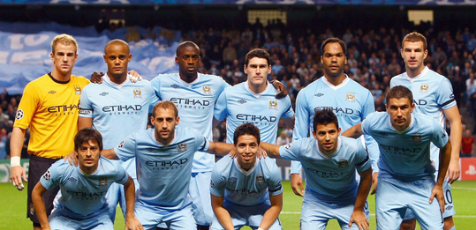
Soccer – Manchester City Fan Engagement
Perhaps the most aggressive use of open data and fan crowdsourcing comes from the Manchester City team in the English Premier League (EPL) for soccer. That organization has partnered with its primary data provider Opta to make all player performance data from all EPL clubs available for analysis by fans and researchers.
Thus far over 5000 fans have downloaded the data. It may prove to help teams in analyzing the massive amount of data that is available on player and team performance.
Source: Thomas Davenport, “Analytics in Sports: The New Science of Winning”, International Institute for Analytics White paper, sponsored by SAS, Feb 2014.
Source: http://www.sas.com/content/dam/SAS/en_us/doc/whitepaper2/iia-analytics-in-sports-106993.pdf
Notes:
Manchester City tried making data available to fans (much like the Duke example) to see if crowdsourcing yielded any additional analytical insights. Not many teams are doing this, but it’s something to get the students (and sports teams at your school) thinking about. Can your business school and engineering/computer science students help your basketball, soccer, or football teams?

Slide 44

Soccer – Manchester City Fan Engagement
“As Gavin Fleig, the team’s head of performance analysis, explains:
The whole reason for putting this data out there is to open the doors. The data has value, previously it has been kept in-house and behind guarded doors, but there is a recognition now that clubs need to help this space develop.
There are a lot of people out there blogging and doing their own research and they can do a lot more with this data. I hope it will have a big impact on those who want to do research. It might just be the armchair enthusiast. If the worst it does is show a few people that there are different ways of looking at a player's performance, then great. If it helps universities and gets the blogging world talking and coming up with fantastic ways of modelling performance, that is what we want. We want to engage with them.”
Source: Thomas Davenport, “Analytics in Sports: The New Science of Winning”, International Institute for Analytics White paper, sponsored by SAS, Feb 2014.
Source: : http://www.sas.com/content/dam/SAS/en_us/doc/whitepaper2/iia-analytics-in-sports-106993.pdf
Notes:
Manchester City tried making data available to fans (much like the Duke example) to see if crowdsourcing yielded any additional analytical insights. Not many teams are doing this, but it’s something to get the students (and sports teams at your school) thinking about. Can your business school and engineering/computer science students help your basketball, soccer, or football teams?

